Slide 1


Slide 2
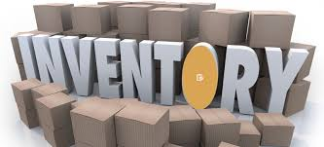

Lecture 5
End of year adjustments: Stock and Depreciation

Slide 3
Learning outcomes
Upon successful completion of the session student will be able to:
1.Recognize the need for adjustments for inventory in preparing financial statements.
2.Record opening and closing inventory.
3.Identify the alternative methods of valuing inventory.
4.Understand and apply the International Accounting Standards
5.Recognise which costs should be included in valuing inventories.
6.Calculate the value of closing inventory using first in, first out (FIFO) and average cost (AVCO) methods.
7.Understand the impact of accounting concepts on the valuation of inventory.
8.Identify the impact of inventory valuation methods on profit

Slide 4
Lecture objectives
What are the end of period adjustments?
Deal with opening and closing stock
Explain alternative stock valuation methods.
Define and explain the purposes of depreciation.
Calculate the annual depreciation charge for a non-current asset under a variety of methods.
Account for depreciation in the ledger accounts and financial statements

Slide 5
End of Year Adjustments
Even if the book-keeping system has been kept up to date there are always some outstanding matters at the end of the financial year
Four types of last minute adjustments:
Stock
Depreciation
Accruals and Prepayments
Bad and Doubtful Debts

Slide 6


Stock (Inventory)
Inventory is the term for the goods available for sale and raw materials used to produce goods available for sale.
Inventory represents one of the most important assets of a business because the turnover of inventory represents one of the primary sources of revenue generation and subsequent earnings for the company's shareholders.

Slide 7
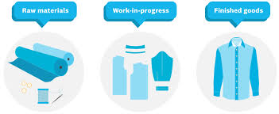
Stock &work in progress
At any point in time most manufacturing and retailing enterprises will hold several categories of inventory including:
-goods purchased for resale
-consumable stores(such as oil)
-raw materials and components
(used in production process)
-partly-finished goods (work in progress)
-finished goods

Slide 8
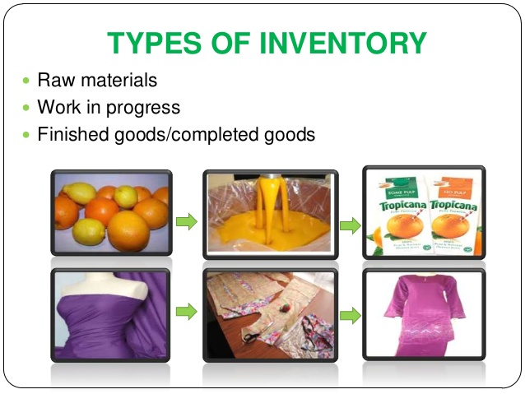
Stock &work in progress

Slide 9
Stock
  In the first year of operation, opening stock is equal to 0.
  In subsequent years, the closing stock of the previous year becomes the opening stock of the following year.
  The amount or value of closing stock (for discrete products) is often obtained through physical counting.
  Why is physical counting necessary to obtain the value of closing stock, why is it not possible to obtain this value from the ledger accounts?

Slide 10
Stock
In calculating the gross profit for the period it is necessary to make some allowance for opening and closing stock.
WHY?
Because we want to match the sales revenue earned for the period with the cost of goods sold, and not the cost of all goods purchased during the period

Slide 11
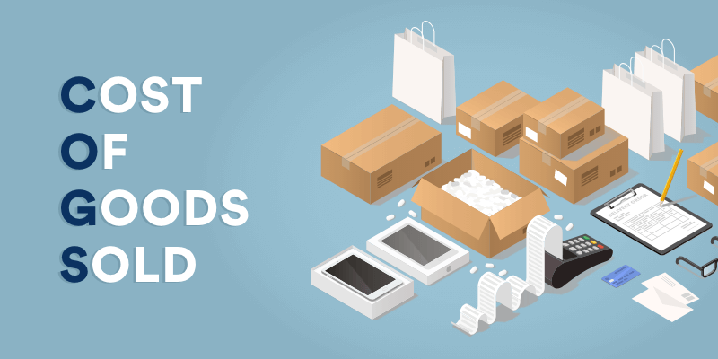
Cost of goods sold (COGS)
COGS is the cost of acquiring or manufacturing the products that a company sells during a period, so the only costs included in the measure are those that are directly tied to the production of the products, including the cost of labor, materials, and manufacturing overhead.

Slide 12
Cost of goods sold (COGS)
For example, the COGS for an automaker would include the material costs for the parts that go into making the car plus the labor costs used to put the car together. The cost of sending the cars to dealerships and the cost of the labor used to sell the car would be excluded.
Also costs incurred on the cars that were not sold during the year will not be included when calculating COGS, whether the costs are direct or indirect.
In other words, COGS includes the direct cost of producing goods or services that were purchased by customers during the year.

Slide 13
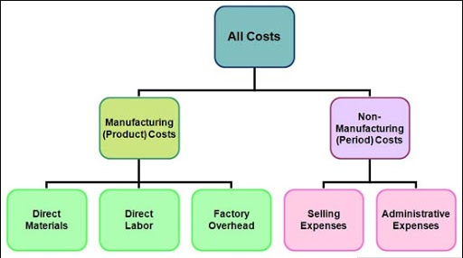
Classification of costs
Cost includes all the expenditure incurred in bringing the product or service to its present location and condition
This includes :
-Cost of purchase –materials costs, import duties, freight.
-Cost of conversion –this includes direct costs and production overheads.

Slide 14
Cost of Goods Sold (COGS)
The standard proforma for calculating sale, cost of sales and gross profit is illustrated below:
$ $
Revenue x
Opening inventory x
Purchases x
Less: Closing inventory (x)
Cost of Sales (x)
Gross Profit x

Slide 15
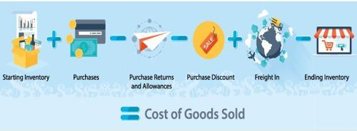
Cost of Goods Sold (COGS)
COGS =
= Opening Stock
Add Purchases
Less Return Outwards (purchase returns)
Add Carriage Inwards
Cost of the goods available for sale
Less Closing Stock

Slide 16
Example: COGS
Peter buys and sells washing machines. He has been trading for many years. On 1 January 20x7, his opening stock is 30 washing machines, which cost $9,500. He purchased 65 machines in the year amounting to $150,000 and at the end of the year he has 25 washing machines left in stock with a cost of $7,500.
Calculate COGS

Slide 17
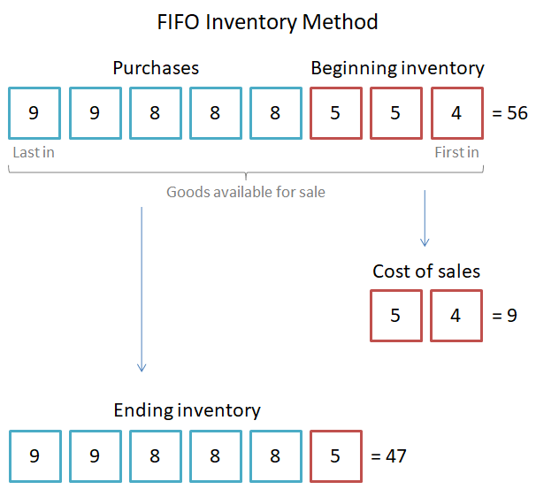
Valuation of stock - FIFO
In FIFO(first-in-first-out), the assumption is made for costing purposes that the first items of inventory received are the first items to be sold.
Thus every time a sale is made, the COGS is identified as representing the cost of the oldest goods remaining in inventory.

Slide 18
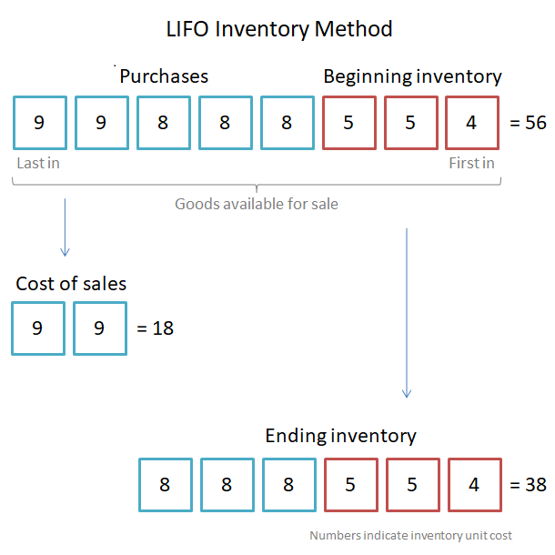
Valuation of stock - LIFO
In LIFO(last-in-first-out), the assumption is made for costing purposes that the last items of inventory received are the first items to be sold.
Thus every time a sale is made, the COGS is identified as representing the cost of the newest goods remaining in inventory.

Slide 19
Valuation: Average cost
Under the weighted average cost formula, the cost of each item is determined from the weighted average of the cost similar items at the beginning of the period and the cost of similar items purchased or produced during the period.
Average cost per unit = Total cost of inventory / No. of units in inventory

Slide 20
How stock valuation method will influence profit?

Slide 21
Net Realizable Value
Net realizable value (NRV) is the revenue expected to be earned in the future when the goods are sold, less any selling costs incurred.
Net realizable value = Saleable value (i.e. what it can be sold for) – Expenses needed before completion of sale (such as costs of delivery to the seller’s shop)
For example: Company ABC Inc. is selling the part of its inventory to Company XYZ Inc. For reporting purposes, ABC Inc. is willing to determine the net realizable value of the inventory that will be sold. The expected selling price of the inventory is $5,000. However, ABC Inc. needs to spend $800 to complete the goods and an additional $200 for transportation expenses.
Considering the available information, the net realizable value of the inventory should be calculated in the following way:
NRV = $5,000 – ($800 + $200) = $4,000

Slide 22
Continuous inventory system
The business may need to count its inventory at the balance sheet date. A formal title for the sheets recording the inventory count is “period end inventory records”.
An alternative would be to have records which show the amount of inventory at any date, i.e. continuous inventory records.
Better information for inventory control.
Avoids excessive build up of certain lines of inventory and having insufficient inventory of other lines.
There is less work to be done to calculate inventory at the end of the accounting period

Slide 23
Periodic inventory system
Periodic inventory system does not maintain a day-to day record of inventories or of the cost of goods sold. The COGS and an updated inventory balance are computed only at the end of the accounting period, when a physical count of inventory is taken.
Cheaper in most situations than the costs of maintaining continuous inventory records.
Even if there is a continuous inventory record, there will still be a need to check the accuracy of the information on record by having a physical check of some of the inventory lines.

Slide 24
Effect of Stock and adjustments
In P&L account COGS is treated as an expense item.
In Balance Sheet closing stock is recorded under current assets
Adjustments:
Opening inventory( Stock)
Dr Cost of Sales
Cr Inventory Asset
Closing inventory( Stock)
Dr Inventory asset
Cr Cost of sales

Slide 25
Need for Depreciation
Fixed asset is earning revenue for the business that will be recognized in the P&L account BUT no part of the cost of the fixed asset is being charged to the P&L account (Matching concept).
Fixed asset remains in the balance sheet at its original cost until it is disposed of. However, it is highly unlikely that the fixed asset’s value will remain that of its original cost over years: it is likely to decrease in value as it is used and ages.

Slide 26
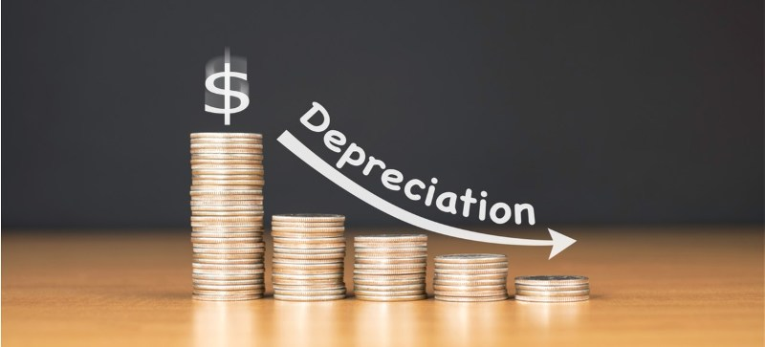
What is Depreciation?
Depreciation is a method of charging a proportion of a fixed asset’s original cost to the P&L account over its “useful economic life” to match with the revenues that the asset earns.
Expenditure on a fixed asset is matched against the income it is helping to generate – either directly (a machine producing items to sell) or indirectly (the premises without which the business could not operate)

Slide 27
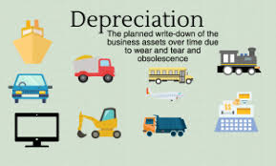
Causes of Depreciation
1. Physical deterioration
1.1. Wear and Tear
1.2. Erosion, rust, rot and decay
2. Economic factors
2.1. Obsolescence.
2.2. Inadequacy.
3. Time
4. Depletion

Slide 28
Depreciation: exceptions
FRS 15 (same with IAS 16 and IAS 23) freehold land does not require depreciation. This is because land does not normally depreciate.
Buildings do, however, eventually fall into despair or become obsolete and must be subject to a charge for depreciation each year.

Slide 29
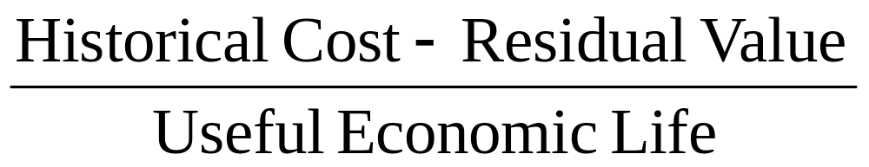
Calculating Depreciation
straight-line method - the depreciation charge is constant over the life of the asset.
*The residual value, also known as salvage value, is the estimated value of a fixed asset at the end of its useful life.

Slide 30
Calculating Depreciation
Mead is a sole trader with a 31 December year-end. He purchased a car on 1st January at a cost of $12,000. He estimates that its useful life is four years, after which he will trade it in for $2,400.
What is the annual depreciation charge?

Slide 31
Depreciation
Depreciation is often expressed as a percentage of original cost
(for example: straight line depreciation at 25% p.a).
If an asset has been purchased in March of 2020, then we should charge to P&L account of 2020 depreciation expense for ONLY 9 months.
Frequently, residual value is not specified, in which case you should assume it to be zero and the whole original cost will be written off over the life of the asset.

Slide 32
Depreciation
(ii) reducing balance method – the depreciation charge is higher in the earlier years of the life of the asset.
This method might be used when a business expects to gain more benefit from the asset in the earlier years of its use.
In the first year the percentage is applied to cost but in subsequent years it is applied to the asset’s net book value (NBV) -(alternatively known as written down value).
Depreciation charge per year= (NBV-Residual value)*depreciation factor
*NBV= Historical cost- Accumulated depreciation

Slide 33
Depreciation
What type of fixed asset might the reducing balance method of depreciation be most useful for?

Slide 34
Which Depreciation method I should use?
Depreciation
FRS 12 requires that the depreciation method used should reflect as fairly as possible the pattern in which the asset’s economic benefits are consumed by the entity

Slide 35
Depreciation
On acquisition of the non-current asset:
Dr Fixed Asset
Cr Cash/Payables
At the end of each year make the adjustments for depreciation:
Dr Income statement – depreciation expenses
Cr Fixed Asset – accumulated depreciation

Slide 36
Depreciation
! Depreciation is not recorded by an entry in the fixed asset account.
The fixed asset account is retained at cost the depreciation charge is credited a separate account.
The reason for this is that we want to show the NBV in the balance sheet by disclosing cost minus the accumulated depreciation over the years since the asset was acquired.

Slide 37
Depreciation
Residual value, useful life and depreciation method should be reviewed at least each financial year end and, if expectations differ from previous estimates, the changes should be accounted for as a change in accounting estimate in accordance with IAS 8.

Slide 38
Summary
Without depreciation the full cost of the asset would appear on the balance sheet each year.
With depreciation the value of the asset on the balance sheet is reduced by the amount of the cumulative annual depreciation charges.
The annual depreciation charge appears in the income statement each year thereby charging the income statement with a proportion of the cost of the non-current asset each year in accordance with the matching or accruals concept.

Slide 39
Lecture Roundup:
1.The cost of goods sold is calculated as:
Opening inventory + purchases – closing inventory.
2. Carriage inwards is included in the cost of purchases. Carriage outwards is a selling expense.
3.Opening inventories brought forward in the inventory account are transferred to the profit or loss account, and so at the end of the accounting year the balance on the inventory account ceases to be the opening inventory value b/f and becomes instead the closing inventory value c/f.
4.Cost can be arrived at by using first in, first out (FIFO) or weighted
average costing (AVCO).
5. Non-current assets are assets which are bought by the business for continuing use. Tangible noncurrent assets are those with physical form.
6. The cost of a non-current asset, less its estimated residual value, is allocated fairly between accounting periods by means of depreciation.
7.Two methods of depreciation are specified in your syllabus.
– The straight line method
– The reducing balance method

Slide 40
References:
Wood, F & Sangster, A (2001) Business Accounting 1, chapters 26, 29.
Dyson, J.R (2004) Accounting for Non-Accounting Students, chapter 5.
ACCA (2017) Approved text for the professional qualification, Study Text 2017, Paper 1. INT,Kaplan publishing: Foulks Lynch, chapter 4 & 7.
Glautier, M & Underdown B (2001) Accounting Theory and Practice, 7th edition, chapters 9 & 10.
ACCA (2017) Approved Interactive Text. Foundations in Accountancy FFA 2017/2018. BPP Media Ltd.

